Slide 1

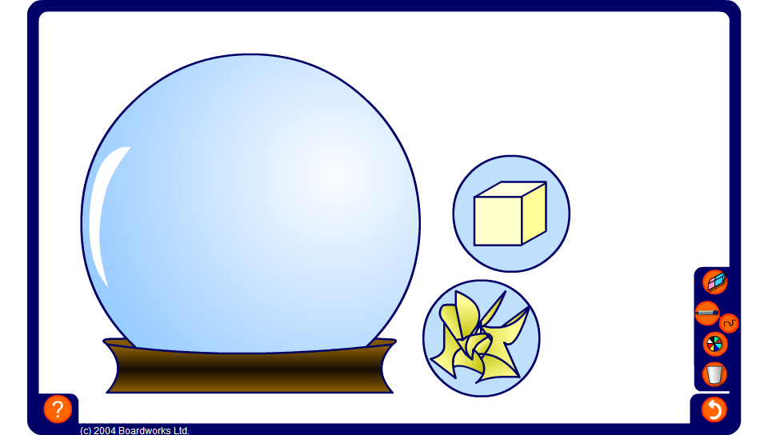


Nets of cubes
Notes:
Six different squares joined together are shown each time this activity is reset. Pupils must decide whether or not they represent the net of a cube.

